Slide 1
When in Doubt: Neural Non-Parametric Uncertainty Quantification for Epidemic Forecasting
Authors: Harshavardhan Kamarthi, Lingkai Kong, Alexander Rodriguez, Chao Zhang, B. Aditya Prakash.
Presenter: Akash Choudhuri.

Slide 2
Contents
Background
Motivation
Contributions
Problem
Method
Overview
Probabilistic Neural Sequence Encoder
Stochastic Data Correlation Graph
Parameterizing Predictive Distribution
Learning the Distribution
Experiments
Discussions/ Takeaways/ Future Work

Slide 3
Background

Slide 4
Motivation
Statistical Approaches for the forecasting problem are fairly new.
Mechanistic models have been the popular choice over time. However, they cannot leverage data from multiple indicators or predict composite signals.
Deep learning approaches have been promising but they need to handle uncertainty to give reliable forecasts.
So-called ‘point’ forecasts are not helpful as they are often not accounting for the uncertainty.

Slide 5
Contributions
The authors designed a Deep Generative Neural Gaussian Process Framework for epidemic forecasting which automatically learns stochastic correlations between query sequences and historical data sequences for nonparametric uncertainty quantification.
The model (EPIFNP) outputs forecast distribution based on similarity between current season’s data till current week and data from each of the historical seasons in a latent space.
Rigorous benchmarking on flu forecasting is performed to assert EPIFNP is clearly superior to other strong baselines in providing up to 2.5x more accurate and 2.4x better calibrated forecasts using standard evaluation metrics.

Slide 6
Problem

Slide 7


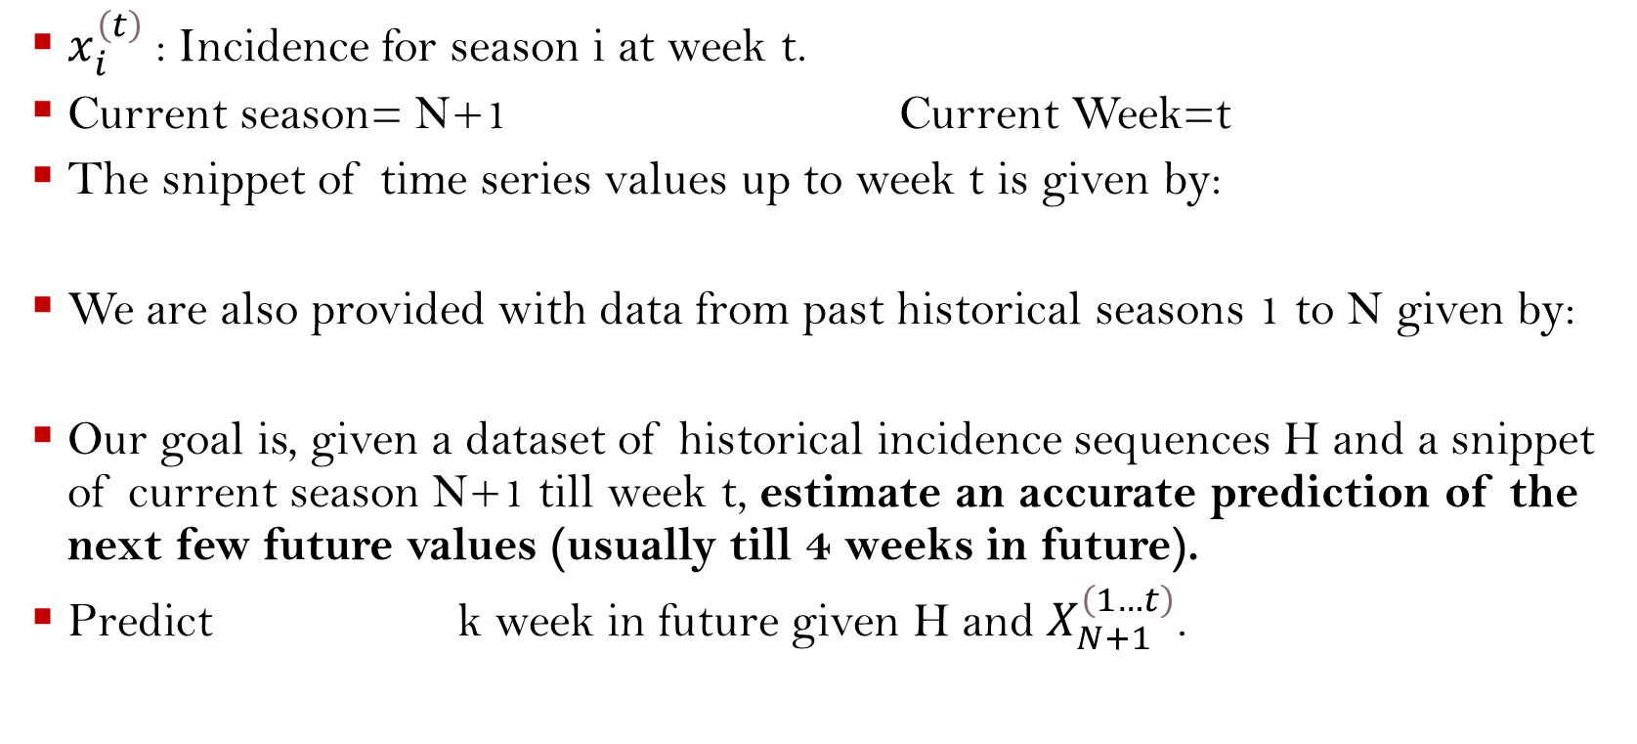
Epidemic Forecasting Task
$x_{i}^{\left(t\right)}$: Incidence for season i at week t.
Current season= N+1 Current Week=t
The snippet of time series values up to week t is given by:
We are also provided with data from past historical seasons 1 to N given by:
Our goal is, given a dataset of historical incidence sequences H and a snippet of current season N+1 till week t, estimate an accurate prediction of the next few future values (usually till 4 weeks in future).
Predict k week in future given H and $X_{N+1}^{\left(1…t\right)}$.

Slide 8
Method

Slide 9





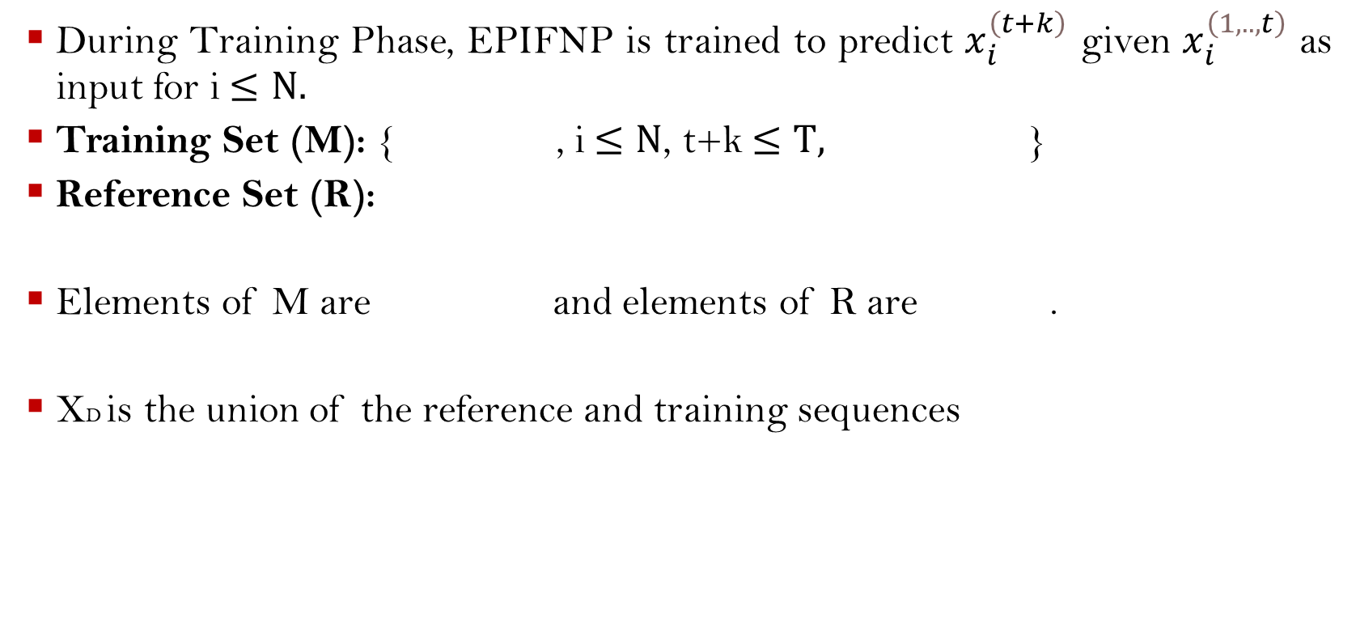
Overview
During Training Phase, EPIFNP is trained to predict $x_{i}^{\left(t+k\right)}$ given $x_{i}^{\left(1,..,t\right)}$ as input for i$≤N.$
Training Set (M): { , i$≤N$, t+k$≤T,$ }
Reference Set (R):
Elements of M are and elements of R are .
XD is the union of the reference and training sequences

Slide 10
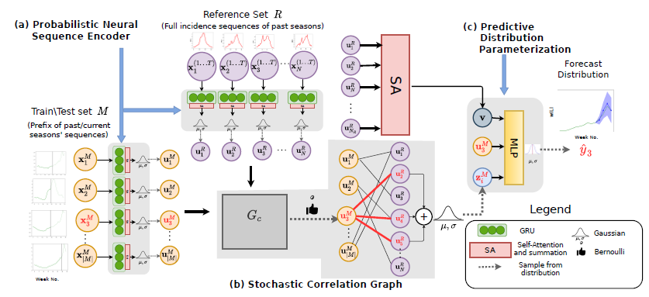
EPIFNP has 3 key steps:
Probabilistic neural sequence encoding: Uses a DSM to encode the sequence into a variational latent embedding .
Stochastic correlation graph construction: Captures correlations between reference and training data points in the latent embedding space.
Final predictive distribution parameterization: 3 stochastic latent variables, namely global and local stochastic latent variables and the stochastic sequence embeddings are passed to a MLP to give the distribution.

Slide 11
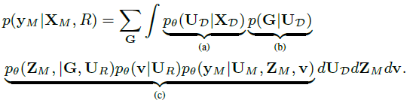
The Factorized Form of the predictive distribution of the training sequence is written as:

Slide 12


Probabilistic Neural Sequence Encoder
Input Sequence is passed through a Gated Recurrent Unit (GRU):
As ILI Data is delayed, we cannot depend fully on the last hidden state:
Ui is then computed as a Gaussian having probability Distribution:
Where g1 and g2 are 2 MLPs and [.]k is the k-th dimension of the variable.

Slide 13
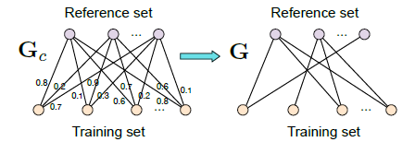

Stochastic Data Correlation Graph (Most Important part of This Work)
It is a bipartite graph from the reference set R to the training set M based on the similarity between their sequence embeddings. It models correlation among sequences.
First we construct complete bipartite graph Gc from R to M where nodes are the sequences. Weight of each edge is the similarity between 2 sequences.
But we use G (a stochastic binary bipartite Graph) to encode data correlations.
The Binary Adjacency Matrix is Parameterized by:

Slide 14

Parameterizing Predictive Distribution
Functional uncertainty is captured from different perspectives:
Local latent variable: Summarizes the information of the correlated reference points for each training point and captures the uncertainty of data correlations. It is given by:
Global latent variable: Encodes the information in all the reference points.
Sequence embedding: A direct path from the latent embedding of the training sequence to the final prediction to enable the neural network to extrapolate beyond the distribution of the reference sequences. This is useful in novel/unprecedented patterns where the input sequence can not rely only on reference sequences from historical data for prediction.

Slide 15


Concatenate the 3 variables into a single vector ei and obtain the final predictive distribution where d1 and d2 are MLPs:

Slide 16


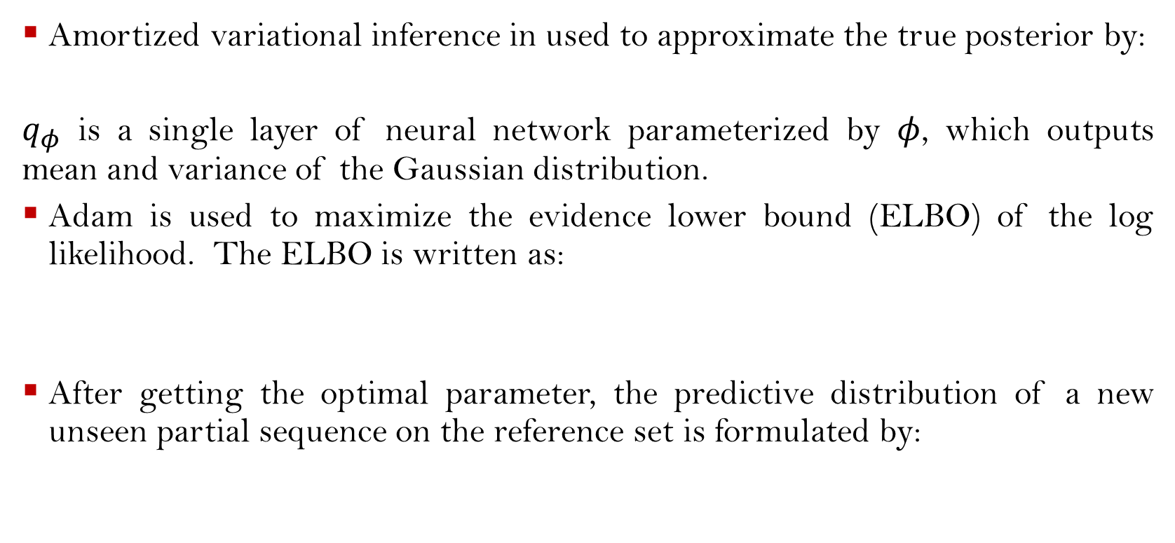
Learning the Distribution
Amortized variational inference in used to approximate the true posterior by:
$q_{φ}$ is a single layer of neural network parameterized by $φ$, which outputs mean and variance of the Gaussian distribution.
Adam is used to maximize the evidence lower bound (ELBO) of the log likelihood. The ELBO is written as:
After getting the optimal parameter, the predictive distribution of a new unseen partial sequence on the reference set is formulated by:

Slide 17
Experiments

Slide 18
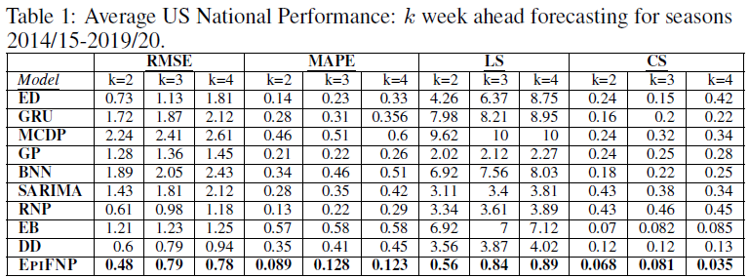
Results
Prediction Accuracy:
EPIFNP significantly outperforms all other baselines for RMSE, MAPE, LS (which measure forecast accuracy). We notice around 13% and 42% improvement over the second-best baseline in RMSE and MAPE respectively. Impressively LS of EPIFNP is 2.5 to 3.5 times less than closest baseline.

Slide 19
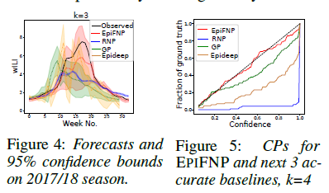
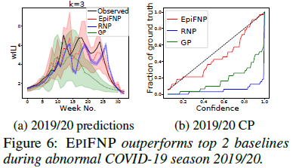
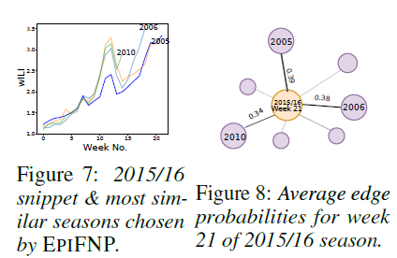
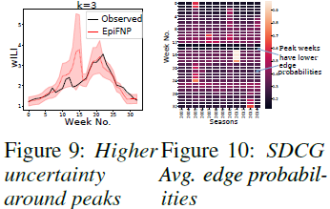
We measure how well calibrated EPIFNP’s uncertainty bounds (Figure
4) are via CS. Calibration Plots (CPs) (Figure 5) show EPIFNP is much closer to the diagonal line (ideal calibration) compared to even the most competitive baselines.

Slide 20
Discussions/ Takeaways/ Future Work

Slide 21
Conclusion
EPIFNP was the only model capable of reliably handling unprecedented scenarios e.g., H1N1 and COVID19 seasons.
EPIFNP automatically retrieves the most relevant historical sequences matching its current week’s predictions.
EPIFNP can be affected by any systematic biases in data collection (for example, some regions might have poorer surveillance and reporting capabilities).
In future works, EPIFNP can be extended to handle other diseases and the core technique can be adapted for other general sequence modeling.
Future variants of EPIFNP can also use heterogeneous data from multiple sources.
Explore incorporating domain knowledge of prior dependencies between different sources/features.

Slide 22
Thank You

